Slide 1
Inference Engine
Notes:
After an optimized IR format model has been generated by MO, the next step is to implement the model into your computer vision application. This is where you will start to use the Inference Engine APIs.

Slide 2
Intel® Deep Learning Deployment Toolkit For Deep Learning Inference
Model Optimizer
A Python* based tool to import trained models and convert them to Intermediate Representation
Optimizes for performance or space with conservative topology transformations
Hardware-agnostic optimizations
Inference Engine
High-level, C/C++ and Python, inference runtime API
Interface is implemented as dynamically loaded plugins for each hardware type
Delivers advanced performance for each type without requiring users to implement and maintain multiple code pathways
Trained Models
Inference Engine
Common API
(C++ / Python)
Optimized Cross-platform Inference
CPU Plugin
Extendibility C++
Caffe*
GPU Plugin
Extendibility OpenCL™
TensorFlow*
Model Optimizer
Convert & Optimize
FPGA Plugin
MxNet*
IR
Myriad Plugin for Intel® NCS & NCS
Extendibility OpenCL™
IR
.data
Load, infer
ONNX*
Pytorch*, Caffe2* & more
HDDL Plugin for VAD*
IR = Intermediate Representation format
Kaldi*
GNA Plugin
GPU = Intel® CPU with integrated GPU/Intel® Processor Graphics, Intel® NCS = Intel® Neural Compute Stick (VPU)
*VAD = Intel® Vision Accelerator Design Products (HDDL-R)
OpenCL and the OpenCL logo are trademarks of Apple Inc. used by permission by Khronos
Notes:
Again, IE is a high-level API, used for reading the converted model, which is the IR files, then loading it to any single or combined Intel devices through the plugin architecture, then initiating inference execution on the selected device or devices.
Each plugin contains complete implementation for inference on this particular device, so users won’t need to recode while shifting from one device to another. Using multiple devices to infer one or multiple models will help to optimize the resources in your system.

Slide 3
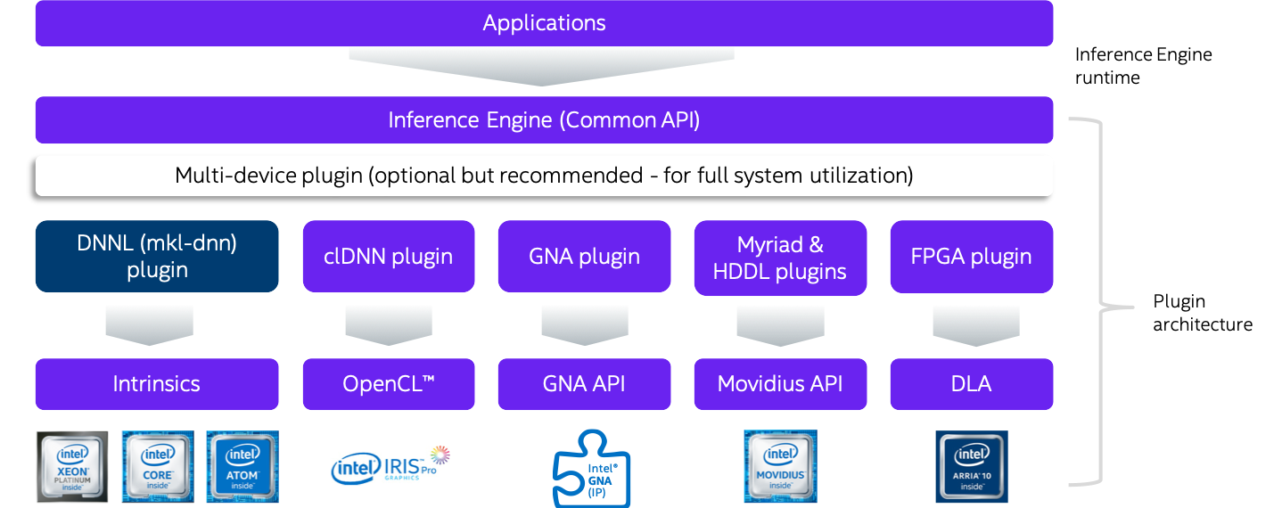
Optimal Model Performance Using the Inference Engine
Core Inference Engine Libraries
Create Inference Engine Core object to work with devices
Read the network
Manipulate network information
Execute and pass inputs and outputs
Device-specific Plugin Libraries
For each supported target device, Inference Engine provides a plugin — a DLL/shared library that contains complete implementation for inference on this device.
GPU = Intel CPU with integrated graphics/Intel® Processor Graphics/GEN
GNA = Gaussian mixture model and Neural Network Accelerator
3
Notes:
Now, let’s review the IE architecture block diagram. There are two categories of libraries of the IE APIs, they are the Core inference engine libraries and the device-specific plugin libraries.
The core IE libraries are used for creating the Inference Engine Core object to work with devices; reading the converted network, which is the IR files; manipulating network information, like the shape of the input and output layer; loading the network to the selected device for inferencing by passing in the preprocessed images to the input layer and reading the outputs of the model for further postprocessing.
When a network has been loaded to the selected device, each device-specific plugin library performs its own internal optimization to the network passed to it at runtime.

Slide 4
Common Workflow for Using the Inference Engine API
exec_net = ie.load_network(network=net, device_name=device, num_requests=request_number)
Create Inference Engine Core object
Read the Intermediate Representation
Prepare inputs and outputs format
Load Network to device & Create infer request
net = ie.read_network(model=model_xml, weights=model_bin)
input_blob = next(iter(net.inputs))
output_blob = next(iter(net.outputs))
ie = IECore()
res = exec_net.infer(inputs={input_blob: in_frame})
Process the results
Prepare input frame
Run Inference
n, c, h, w = net.inputs[input_blob].shape
in_frame = cv2.resize(image, (w, h))
in_frame = in_frame.transpose((2, 0, 1))
in_frame = in_frame.reshape((n, c, h, w))
Inference loop
http://docs.openvinotoolkit.org/latest/_docs_IE_DG_Integrate_with_customer_application_new_API.html
Notes:
This slide shows the common workflow for using the IE API. First of all, we need to create an IE core object, everything else that follows are functions of this core object.
Then use the “readnetwork” function of the core object to read the IR files, this will create a network object to represent the model in the host memory.
Next, we will need to know the information, in most cases, the layout of the input and output layers.
Then we use the “loadnetwork” method of the core object to compile and load the network onto the selected device, which will create an executable network object, and we can also set the inference numbers here for parallel inferencing.
Next, we will need to prepare our input images to align with the layout info we read from the input layer earlier, this is also known as preprocessing, which includes the image resizing and transposing.
Then, we start the inference by using the “infer” function of the executable network.
Lastly, process the output of the model, as we mentioned earlier, different types of model have different output formats, and users have their own ideas of how to deal with those outputs, so this part are the user-defined functions. If you are processing multiple images or video streams, then the last two steps will be in a big loop, until the end of the frames.

Slide 5
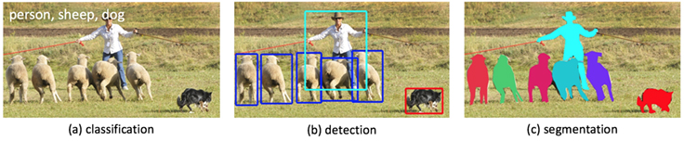
Inference on an Intel® Edge System
Many deep learning networks are available—choose the one you need.
The complexity of the problem (data set) dictates the network structure. The more complex the problem, the more ‘features’ required, the deeper the network.
Notes:
Before we dive into IE, let's quickly overview what those models can do to help us solve the CV problems. As you have already seen from the MO demo, many different models or neural networks are available, generally speaking, those models fall into three main types: Classification, Detection, and Segmentation, they all take one or several frames as input, but the output of the model defines its function.
First, Classification, also known as object recognition, it is used for indicating what's in that frame, normally the output of a Classification model is the class IDs and the corresponding confidence number or probability. In the example shown on this page, the person, sheep, and dog should have the highest confidence number than all the other classes the model can recognize;
Next, Detection, not only telling us what's in a given frame, but also providing position information. Commonly in a detection model's output we can see the class ID, confidence number along with the object x, y coordinates. Based on the outputs, we can draw the bounding boxes on the detected objects and apply different colors for different classes of objects;
Furthermore, Segmentation, is an extension of object detection. Instead of returning x, y coordinate numbers, semantic segmentation models return a "painted" version of the input image, where the "color" of each pixel represents a certain class. The segmentation networks are much bigger than respective object detection models, but they provide a pixel-level localization of objects and they can detect areas with complex shapes.

Slide 6
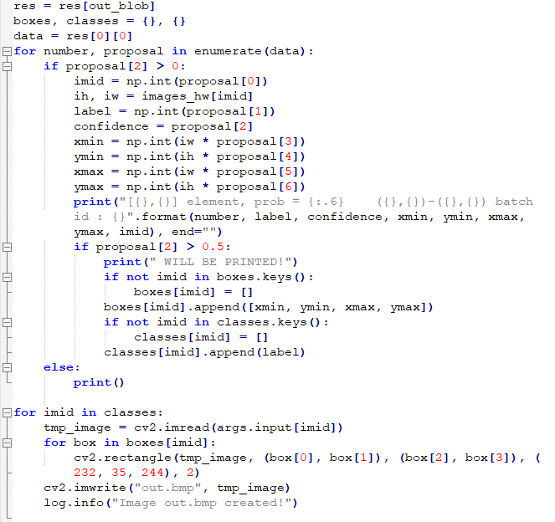
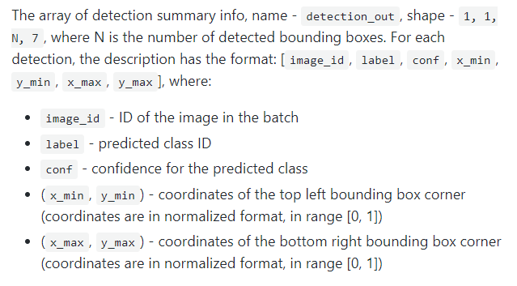
Process the results Object Detection SSD example
Process the results (Post-processing)
Notes:
For the SSD model, here we take mobilenet-ssd as an example since we just converted it with MO in the previous demo. We list the output format of mobilenet-ssd on the left, it is from the description of the model, and we can see for each detected object, the output contains its image ID, label, confidence, and the x, y coordinates.
While on the right hand is the snippet of code for processing the output, it enumerates the detected objects, if their confidence number is greater than 0, then prints out all the information about this object. Furthermore, if the confidence number is greater than 0.5, then it will be worthy to draw the bounding box around the object.

Slide 7
Inference Engine Synchronous vs Asynchronous Execution
INTEL® DISTRIBUTION OF OPENVINO™ TOOLKIT
In IE API model can be executed by Infer Request which can be:
Synchronous - blocks until inference is completed.
exec_net.infer(inputs = {input_blob: in_frame})
Asynchronous – checks the execution status with the wait, or specify a completion callback (recommended way).
exec_net.start_async(request_id = id, inputs={input_blob: in_frame})
If exec_net.requests[id].wait() != 0
do something
Sync API
Transfer 1
Transfer 2
Inference 1
Inference 2
Result 1
Result 2
time
Async API
Result 1
Result 2
Transfer 1
Transfer 2
Inference 1
Inference 2
Notes:
By far we have talked about the basic usage of IE. Now let’s continue with some other APIs that were not covered in the block diagram of IE.
First, the Async API, which enables executing multiple requests asynchronously, it splits synchronous "Infer" into "StartAsync" and "Wait". While the accelerator is busy with the inference, the application can continue doing things on the host rather than wait for the inference to complete.
So the overall framerate is determined by the MAXIMUM(detection time, input capturing time) and not the SUM(detection time, input capturing time), which helps to improve the overall frame rate of the application.

Slide 8
Inference Engine Throughput Mode for CPU, iGPU and VPU
INTEL® DISTRIBUTION OF OPENVINO™ TOOLKIT
Latency – inference time of 1 frame (ms).
Throughput – overall amount of frames inferred per 1 second (FPS)
“Throughput" mode allows the Inference Engine to efficiently run multiple infer requests simultaneously, greatly improving the overall throughput.
Device resources are divided into execution “streams” – parts which runs infer requests in parallel
Device resources
Infer Request 1
Execution stream 1
Infer Request 2
Execution stream 2
Infer Request N
Execution stream N
time
CPU Example:
ie = IECore()
ie.GetConfig(CPU, KEY_CPU_THROUGHPUT_STREAMS)

Slide 9
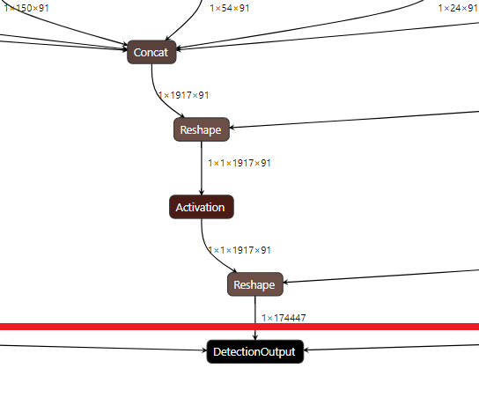
Inference Engine Heterogeneous Support
INTEL® DISTRIBUTION OF OPENVINO™ TOOLKIT
You can execute different layers on different HW units
Offload unsupported layers on fallback devices:
Default affinity policy
Setting affinity manually (CNNLayer::affinity)
All device combinations are supported (CPU, GPU, FPGA, MYRIAD, HDDL)
Samples/demos usage “-d HETERO:FPGA,CPU”
FPGA
InferenceEngine::Core core;
auto executable_network = core.LoadNetwork(reader.getNetwork(), "HETERO:FPGA,CPU");
CPU
Notes:
Next, the Hetero Plugin. It enables inferencing one network on several devices. Why do we want to do that? Because we’d like to offload the heaviest computation to the right computing resources.
Each device has its own supported and unsupported layers. With the evolving of OpenVINO, more and more layers will be supported by those devices, you can check this out on the OpenVINO documentation, CPU is always the most flexible device, it supports all the layers other devices support, so CPU can always be the fallback device.
Basically, two steps behind the hetero plugin, once you decide to run the inference on two or three devices, the hetero plugin will set the affinity of layers to those devices, then the divided network will be loaded and executed on the corresponding plugin.
The rule used for automatically setting the affinity of layers is related to the sequence of the devices you put for the hetero plugin. It will assign all the supported layers for the top priority device, then fallback the unsupported layers to the second priority device.
If there are unsupported layers for the secondary priority device, it will continue fallback to the third device. In the previous sample code, we see during the loading network step, we put a device name there, and the IE will create the executable network object for that device. To use hetero plugin, just simply put Hetero, colon mark, followed with device names, separated with commas as we showed on the screen.
Data needs to be transferred between layers during inference, but adjacent layers now can be executed on different devices.
Then, if it takes a relatively long time to transfer data from one part of the network to another in a heterogeneous model, it makes no sense to execute them in a heterogeneous mode on these devices.
In this case, you can manually set the correlation to avoid sending data back and forth multiple times during one reasoning. To do this, you will need to query the network first, it will need to know the name and sequence of the device you want to run inference on, and then you will get automatic layer affinity information, which can then be modified from there.

Slide 10
Inference Engine Multi-device Support
INTEL® DISTRIBUTION OF OPENVINO™ TOOLKIT
Automatic load-balancing between devices (inference requests level) for full system utilization
Аny combinations of the following devices are supported (CPU, iGPU, VPU, HDDL)
As easy as “-d MULTI:CPU,GPU” for cmd-line option of your favorite sample/demo
C++ example (Python is similar)
Application
Device priority
Infer requests
Inference Engine
Queue Manager
CPU queue
GPU queue
VPU queue
CPU Plugin
GPU Plugin
VPU Plugin
Core ie;
ExecutableNetwork exec = ie.LoadNetwork(network,{{“DEVICE_PRIORITIES”, “CPU,GPU”}}, “MULTI”)
CPU
GPU
VPU
etc
Notes:
Compared to the Hetero plugin, which breaks one network into parts and then runs inference on different devices, another plugin called Multi plugin loads the same entire network onto multiple available devices to execute in parallel. This is another way of utilizing available computing resources.
With Multi plugin, throughput definitely will be improved compared to running the same workload on a single device, also you will achieve more consistent performance since the devices can now share the inference burden so that if one device is becoming too busy, another device can take more of the load.
To use the Multi plugin, you don't need to explicitly load the network to every device, like create and balance the inference requests, from the application point of view, this is just another device that handles the actual machinery. So, just like loading the network to a single device or Hetero plugin, here just change the device name to MULTI, colon mark, and device names, unlike the hetero plugin, the sequence of devices does not matter here.

Slide 11

Speed up development with open source resources
Open source resources with pre-trained models, demos, and tools
The Open Model Zoo demo applications are console applications that demonstrate how you can use your applications to solve specific use-cases.
Smart Classroom
Recognition and action detection demo for classroom settings
Weld Porosity Detection
Demonstrates how to find defects in welding
Multi-Camera, Multi-Person
Tracking multiple people on multiple cameras for public safety use cases
Person Inpainting
Removes unwanted people in images or videos
And more..
Gaze Estimation
Face detection followed by gaze estimation, head pose estimation and facial landmarks regression.
Demo applications
https://github.com/opencv/open_model_zoo
Copyright © 2020, Intel Corporation. All rights reserved.
For public use – OK for non-NDA disclosure
Notes:
Open Model Zoo also provides demos, which are console applications that demonstrate how you can use the Inference Engine in your applications to solve specific use-cases.

